Slide 1

21MAT212
END SEMISTER PROJECT
MATHEMATICS FOR INTELLIGENT SYSTEMS - 4
MATRIX
FACTORIZATION

Slide 2

21MAT212
Matrix Factorization
Matrix Factorization is an approximation of a matrix into a product of matrices.
we will be able to produce the original matrix by multiplying all the resulting ‘factor’ matrices together.
We can perform more complex operations on factors.
It helps in the imputation of missing/incomplete data, image segmentation and noise removal, and compression.
02
03
04

Slide 3
21MAT212
Matrix Factorization
There are many different matrix decomposition techniques,
To solve linear equations, the matrix decomposes into 2 parts. (LU decomposition, QR decomposition)
Eigenvalue-based decomposition is mostly applicable to square matrices. Where matrix decomposes into 3 parts (final rotation, scaling, initial rotation). PCA and Singular Value Decomposition are one of the methods.
03
04
05

Slide 4
KEY
TERMS
04
05
06

Slide 5
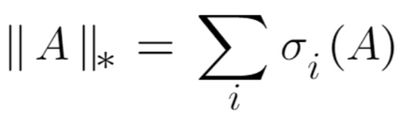
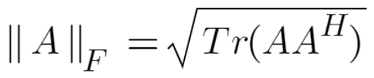
21MAT212
Nuclear Norm
The nuclear norm (sometimes called Schatten 1 -norm or trace norm) of a matrix A, denoted by ||A||∗, is defined as the sum of its singular values.
It is also a proxy for rank. And is a convex problem unlike rank .
Frobenius Norm
The Frobenius norm is a norm of a matrix A of m*n is defined as the square root of the matrix trace of AA*, where A* is the conjugate transpose.
05
06
07

Slide 6
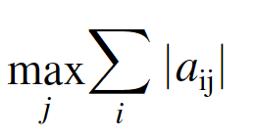
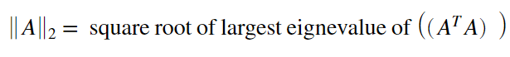
21MAT212
L1 Norm Of Matrix
It is equal to the LARGEST L1 norm of columnS of the matrix.
L2 Norm Of Matrix
05
06
07

Slide 7
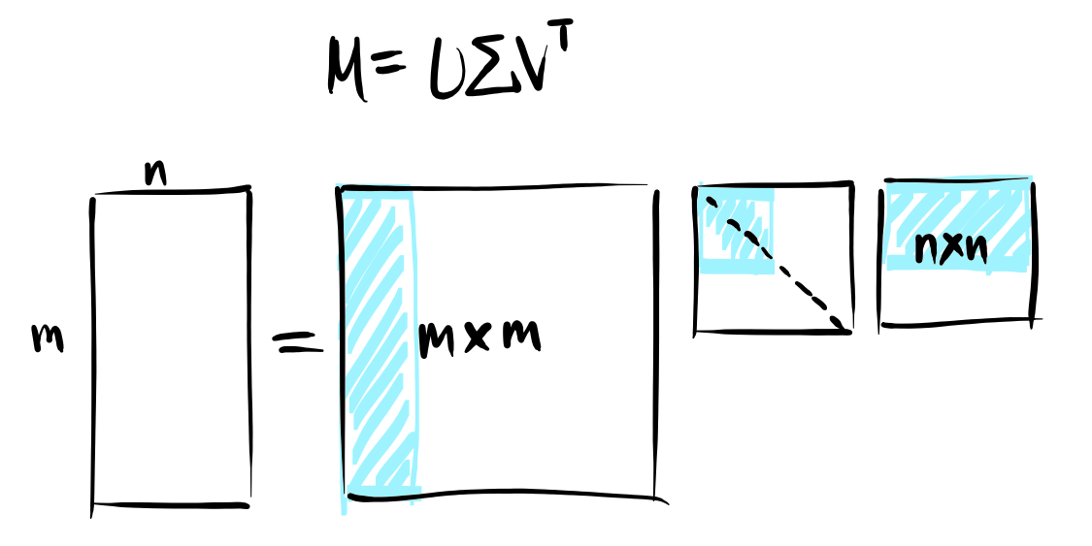
21MAT212
WHAT IS SVD
SINGUALAR VALUE DECOMPOSITION
m x n
r x r - non zero values
M - matrix with rank r.
U - orthonormal columns.
∑ - square diagonal matrix[zero rows in bottom ].
V - orthonormal columns.
r - rank
U will be m*m and V' be n*n
but as singular values will be zero beyond r they form right/left null spaces
08

Slide 8
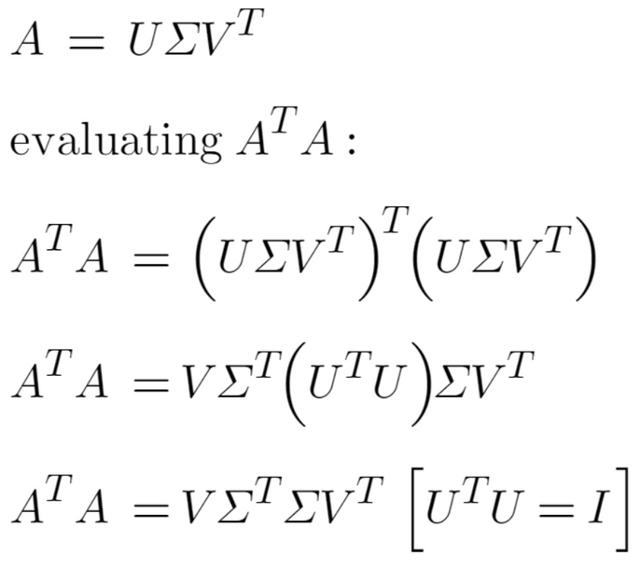
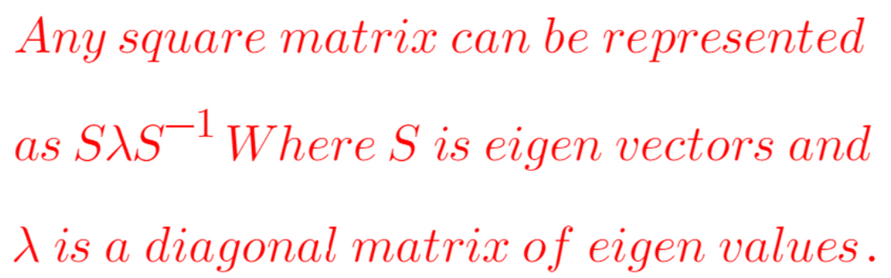
21MAT212
what IS U,V,SINGULAR VALUES
07
08
09

Slide 9
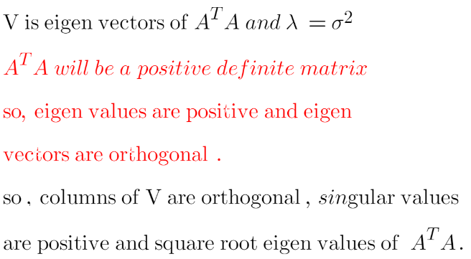
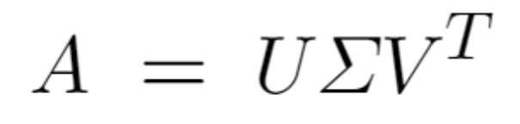
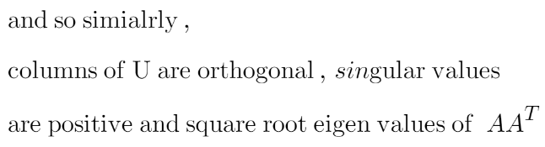
21MAT212
U,V,SINGULAR VALUES
08
09
10

Slide 10
21MAT212
HOW SVD AND FUNDAMENTAL SPACES ARE RELATED
Subspace | Subspace of | Dimension | Basis
Column Space | R^m | r (Rank(M)) | First 'r' columns of U
Null Space | R^n | n - r | Last 'n-r' columns of V
Row Space | R^n | r | First 'r' columns of V
Left Null Space | R^m | m - r | Last 'm-r' columns of U
09
10
11

Slide 11
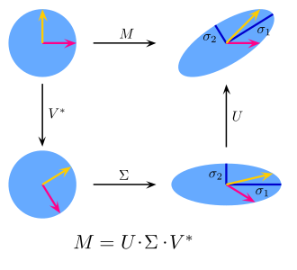
21MAT212
INTEPRETATION
The vector x can be linear transformed by matrix A in a way that, U and V' is responsible for rotations of the space, while∑ represents the scaling of each coordinate by the factor σi.
From the fig, the singular values can be interpreted as the magnitude of the semiaxes of an ellipse in 2D.
10
11
12

Slide 12

LOW-RANK MODELS

Slide 13
21MAT212
Low-Rank Models
LRM is useful for reconstructing the missing values and identifying important features in heterogeneous data.
Given large collections of data with numeric and categorical values, entries in the table may be noisy or even missing altogether.
Low-rank models facilitate the understanding of tabular data by producing a condensed vector representation for every row and column in the dataset.
12
13
14

Slide 14








21MAT212
MADHAV
SVS
PRASH
RISHITH
1 | 1 | 5 | 4
2 | 1 | 4 | 5
4 | 5 | 2 | 1
5 | 4 | 2 | 1
4 | 5 | 1 | 2
1 | 2 | 5 | 5
VIKRAM
VADA CHENNAI
THOR : LOVE AND THUNDER
CHARLIE 777
DOCTOR STRANGE
BEAST

Slide 15
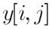


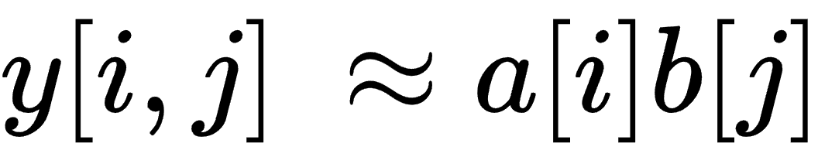

21MAT212
RANK 1 MODEL
Rating of a movie by a user
MOVIE
USER
a - Users [Some users might be generous]
b - Movies[Some movies might be popular]
a,b ==> features
MODEL: Combing the features multiplicatively
13
14
15

Slide 16
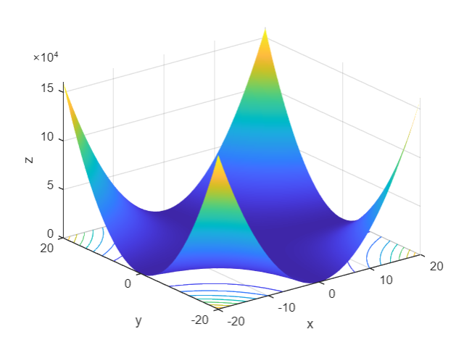

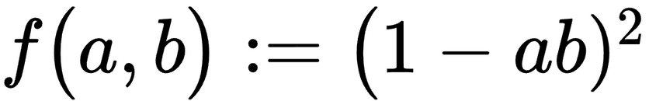

21MAT212
MODEL 1
We fit these parameters using observed data by minimizing a least-squares cost function
only one movie and one user and the rating
equals one
Actual
Predicted
Plot of the example
the optimization problem is not convex
14
15
16

Slide 17
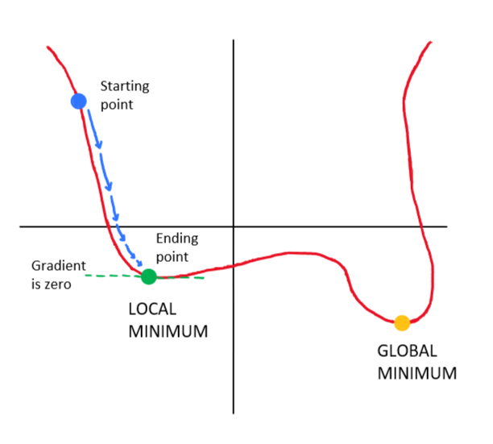
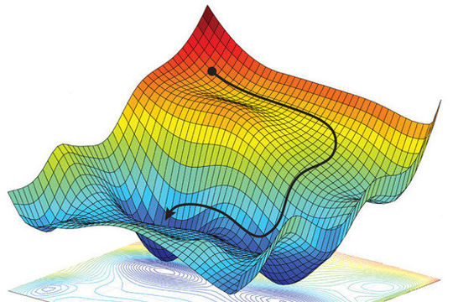
21MAT212
NON CONVEX
Algorithms such as gradient descent to
minimize the cost function, they may get stuck in local minima corresponding to parameter values
that do not fit the data well.
Non -convexity is problematic
15
16
17

Slide 18
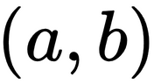
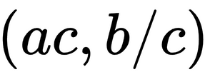
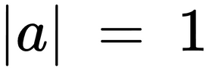
21MAT212
Scaling issue
The pairs and yield the same cost for any
constant c.
SOLUTION
Include a constraint to restrict the magnitude of some of the parameters.
Like setting constraint
which is a nonconvex constraint set.
16
17
18

Slide 19
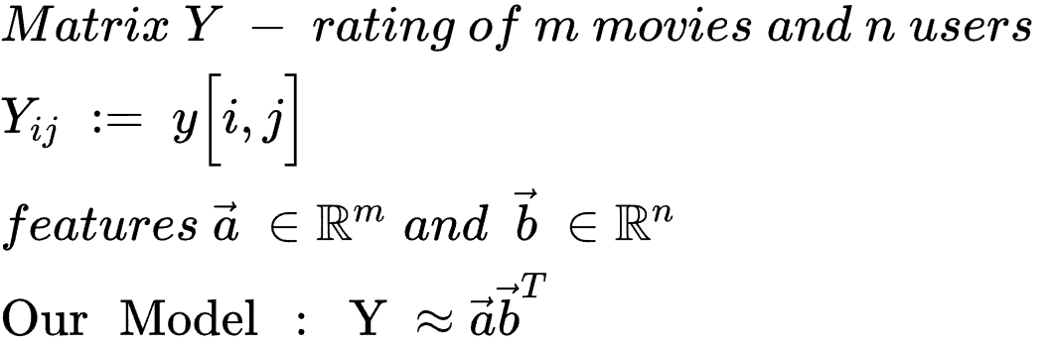

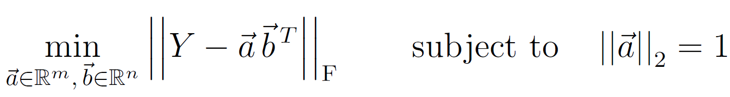
21MAT212
generalizing model 1
Outer Product that gives the
rating matrix from features
Now we fit by solving optimization problem
17
18
19

Slide 20
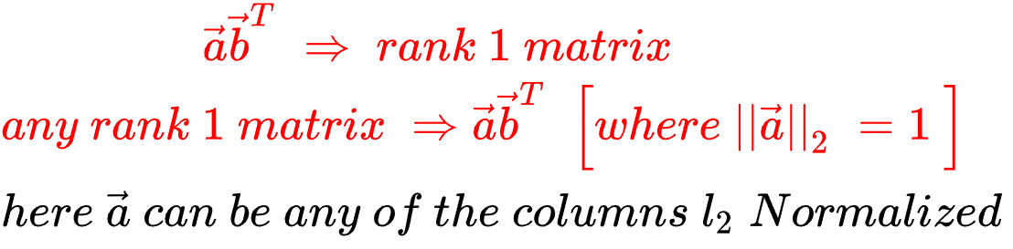
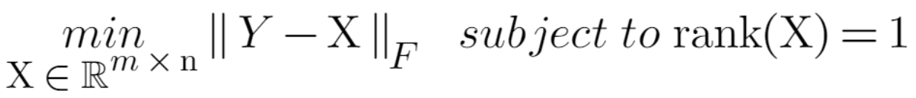
21MAT212
18
19
20

Slide 21
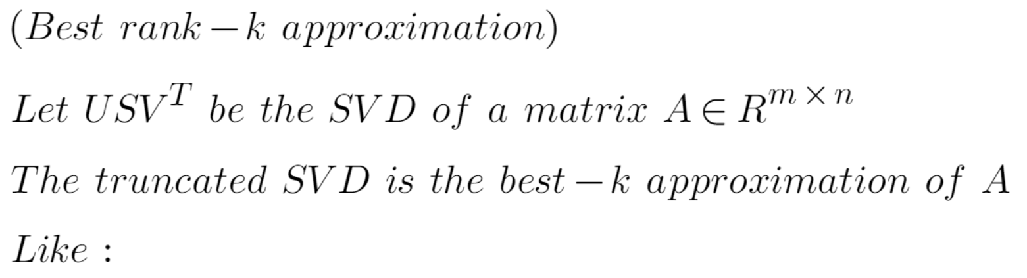
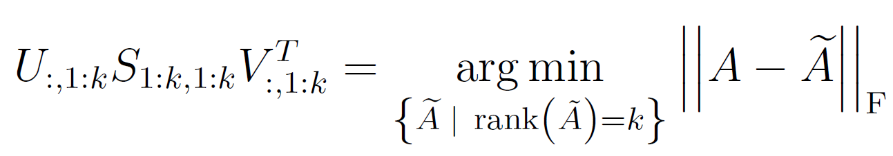
21MAT212
So the solution to our problem is given by
truncated SVD
19
20
21

Slide 22
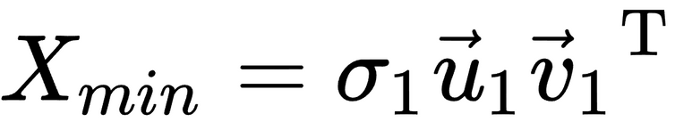
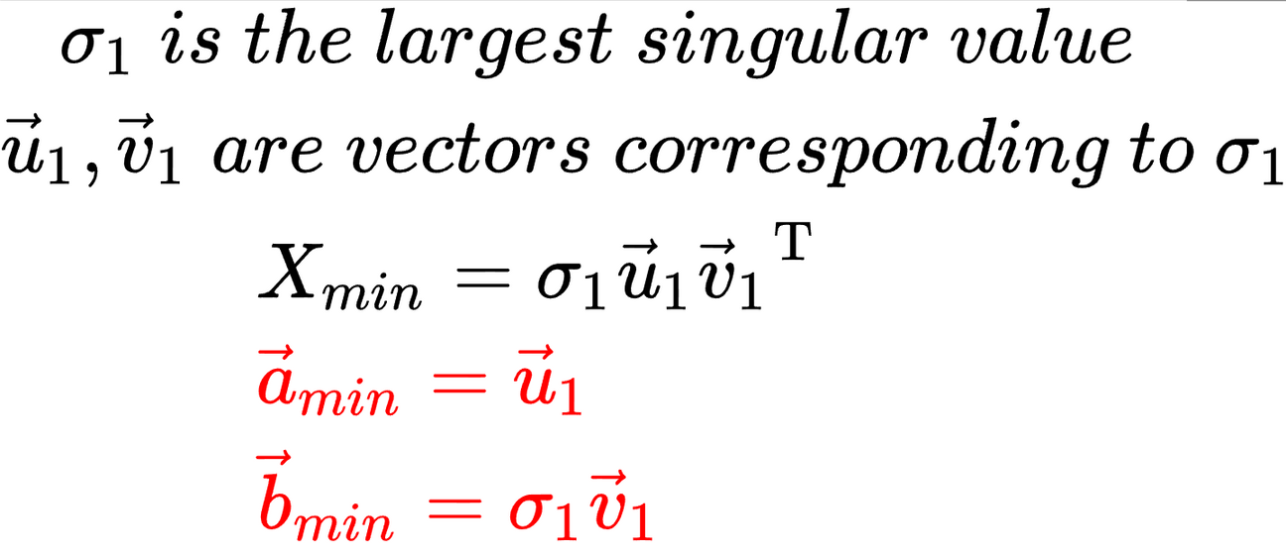
21MAT212
This means we finally have
the a , b features
which are needed to reconstruct our
RATING MATRIX (Y)
TEAM - 11
20
21
22

Slide 23
21MAT212
NOW THAT WE HAVE SEEN HOW TO FIND FEATURES A AND B LET'S TEST IT OUT WITH AN EXAMPLE
21
22
23

Slide 24
21MAT212
MADHAV
SVS
PRASH
RISHITH
1 | 1 | 5 | 4
2 | 1 | 4 | 5
4 | 5 | 2 | 1
5 | 4 | 2 | 1
4 | 5 | 1 | 2
1 | 2 | 5 | 5
VIKRAM
VADA CHENNAI
THOR : LOVE AND THUNDER
CHARLIE 777
DOCTOR STRANGE
BEAST
22
23
24

Slide 25
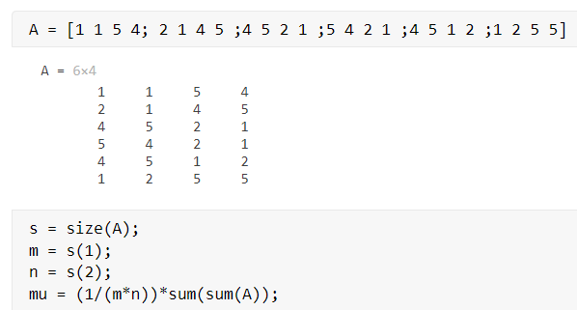
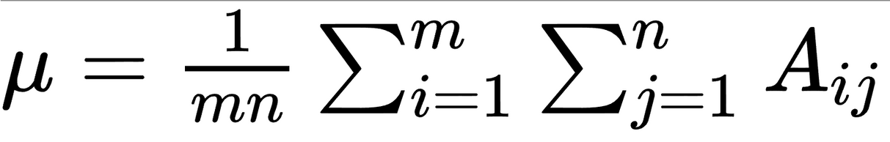
21MAT212
SOLVING FOR RANK 1
Load Matrix , subtract the average rating
23
24
25

Slide 26
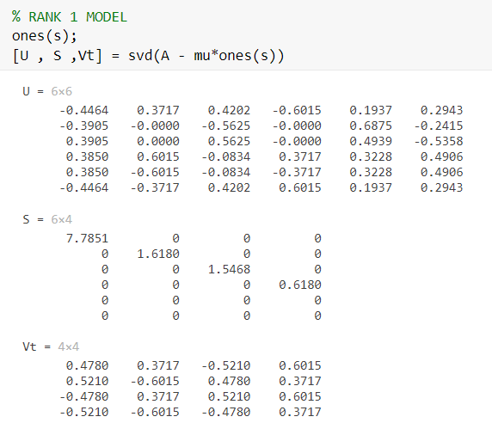

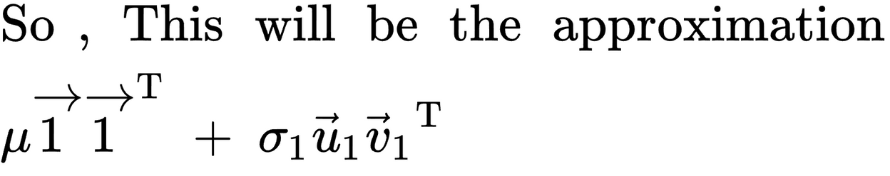
21MAT212
Now calculating SVD for the centered matrix
1st singular value is larger than
For the rest So, the matrix may be well approximated by a rank-1 matrix
24
25
26

Slide 27
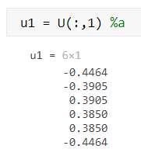
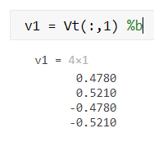
21MAT212
Ananlyse the features
VIKRAM
Madhav
Svs
prash
Loki
VADA CHENNAI
THOR : LOVE AND THUNDER
CHARLIE 777
DOCTOR STRANGE
BEAST
LIKES ACTION MOVIES
ACTION MOVIES
25
26
27

Slide 28
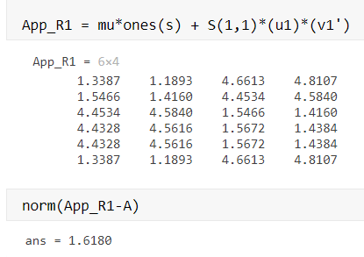
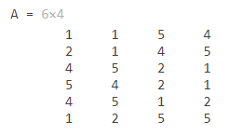
21MAT212
RECONSTRUCTING USING a,b
We can see that the reconstructed matrix is very colse
26
27
28

Slide 29
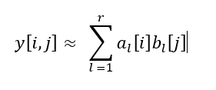
21MAT212
RANK - r MODEL
Different people like different movies.
r factors - capture the dependence between the ratings and the movie/user
MODELS => learns factors => directly from data
some cases , we can interpret like in rank 1 - BUT NOT ALWAYS
Eg: we can associate user age , movie genres in features
27
28
29

Slide 30
21MAT212
MODEL R
Similar to rank 1 , we can compute by using SVD [just take more vectors ]
Also , as a,b are formed from orthogonal nature, they might not be interpretable
28
29
30

Slide 31
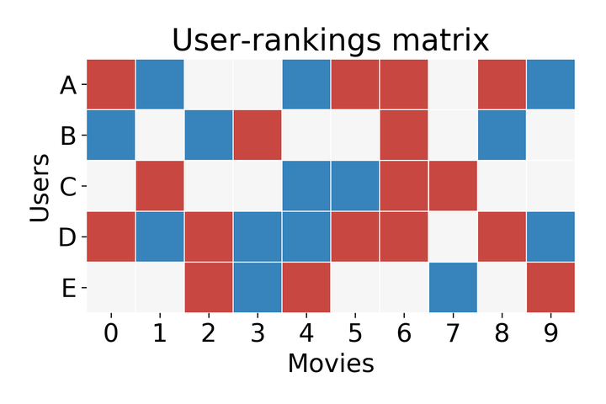
MATRIX COMPLETION

Slide 32










Slide 33
21MAT212
The problem :
Predicting ratings can be recast as that of completing a matrix from
some of its entries.
This is matrix completion.
Missing data
This might seem ill posed, or like under determined systems .
So to solve >> make assumptions >> ORGINAL MATRIX IS LOW RANK
MEANS : High correlation between the entries
31
32
33

Slide 34
21MAT212
WELL POSED
With low-rank assumption
Matrix with mxn dimensions can be factorized
into mxr and rxn.
Encodes the matrix into r(m+n)
Basic Requirements for the matrix :
1. Number of entries larger than r(m + n), But this is not enough.
2. We need samples that are distributed across the whole
matrix. At least one per row, column.
3. If we have localized entries, It will be impossible to
recover them.
32
33
34

Slide 35
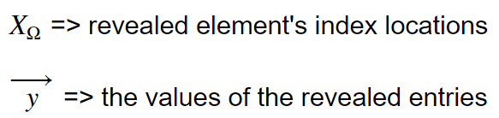
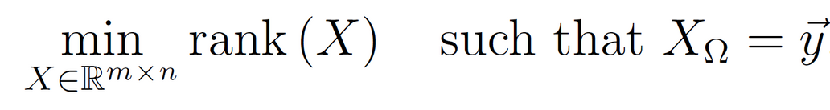
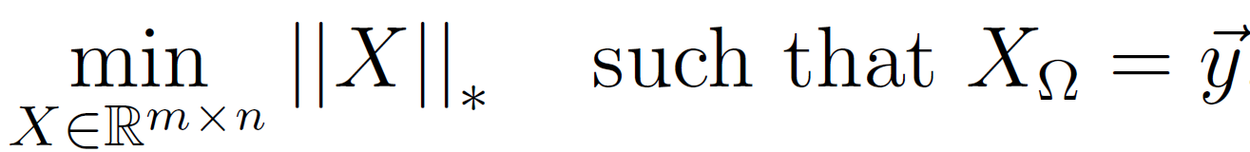
21MAT212
Minimizing the nuclear norm
We need matrix with lowest rank and values matching with given values
min rank is hard, so we use nuclear norm, as it is a convex cover and easy to solve
33
34
35

Slide 36
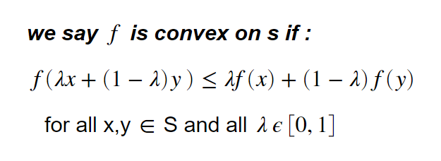
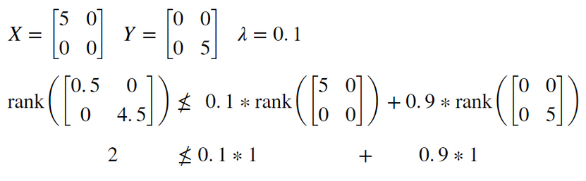
21MAT212
CONVEXITY TEST
CONVEXITY OF RANK()
Rank() is Non - Convex
33
34
35

Slide 37
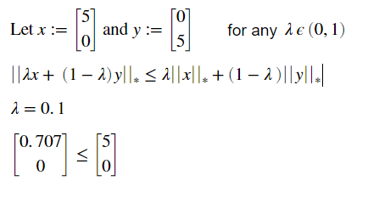
21MAT212
CONVEX TEST
CONVEXITY OF NUCLEAR NORM
Nuclear Norm is Convex
33
34
35

Slide 38

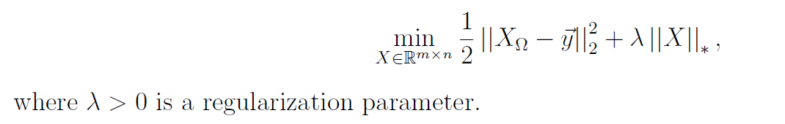
21MAT212
cost function - convex
constrain - linear
So now also as the revealed entries will be noisy we remove the constrain and add the constrain as a penalty term with l2 norm
34
35
36

Slide 39




21MAT212
Implementation
We now apply this method to the following
completion problem:
MADHAV
SVS
PRASH
LOKI
1 | ? | 5 | 4
? | 1 | 4 | 5
4 | 5 | 2 | ?
5 | 4 | 2 | 1
4 | 5 | 1 | 2
1 | 2 | ? | 5
VIKRAM
VADA CHENNAI
THOR : LOVE AND THUNDER
CHARLIE 777
DOCTOR STRANGE
BEAST
35
36
37

Slide 40
21MAT212
SOLVING PROCESS
MADHAV
SVS
PRASH
LOKI
1 | ? | 5 | 4
? | 1 | 4 | 5
4 | 5 | 2 | ?
5 | 4 | 2 | 1
4 | 5 | 1 | 2
1 | 2 | ? | 5
VIKRAM
VADA CHENNAI
THOR : LOVE AND THUNDER
CHARLIE 777
DOCTOR STRANGE
BEAST
Compute the average observed rating and subtract it from each entry in the matrix.
solve the minimization of the nuclear norm over the given entries
add the average observed rating to the solution of the optimization problem and roundeach entry to the nearest integer.
36
37
38

Slide 41
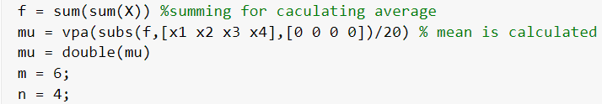
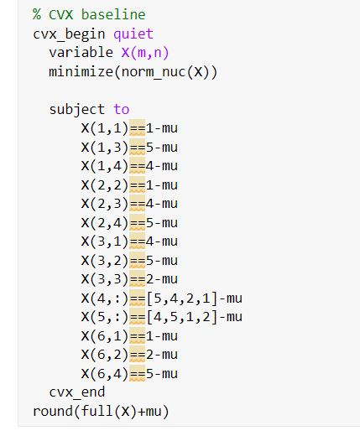
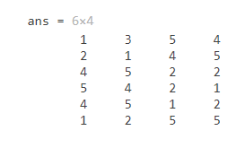
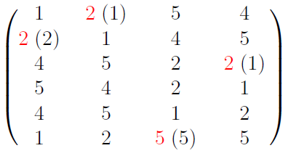
INITIAL eq using cvx
CODE
21MAT212
SOLVING
OUTPUT
We see our coded cvx implementation almost matches
37
38
39

Slide 42
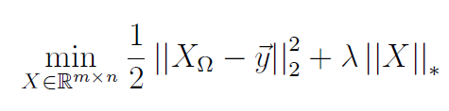


final eq using cvx
21MAT212
SOLVING
CODE
OUTPUT
38
39
40

Slide 43


21MAT212
Algorithm - THEOREM
Proximal gradient method to solve
THE NON-CVX
STYLE OF SOLVING
39
40
41

Slide 44







21MAT212
Algorithm
the filled values of the complete matrix
a matrix such that
the matrix with indices of the filled elements
the initial X is set to Y and is later updated in each itrations
the incomplete elements of the iterating X is set to 0
Step size , is > 0
40
41
42

Slide 45


ALGORITHM - MATLAB
21MAT212
We will solve this without cvx
Function - written based on the theorem
Initializing Y
41
42
43

Slide 46

ALGORITHM - MATLAB
21MAT212
we try 19 * 19 values for our hyper parameter and chose the best
42
43
44

Slide 47


ALGORITHM - MATLAB
21MAT212
OUTPUT
To compare
43
44
45

Slide 48



21MAT212
Alternating minimization [AMA]
Our method requires repeadly computing SVD
computationally heavy for large matrices
The k which is the rank can be set by cross validation
and that's how we minimize the rank
AGAIN CONVEX ?
A and B is fit by solving this
least-squares optimization problem
44
45
46

Slide 49





21MAT212
AMA ALGORITHM
nonconvex problem is usually tackled by alternating minimization
Iteratively solving
we get a local minimum of the cost function.
45
46
47

Slide 50

21MAT212
Nonnegative matrix factorization
negative singular entries that are difficult to interpret.
rating negative ratings mean that a person does not like a movie.
BUT
For other problems, negative will not make sense
So , we apply nonnegative matrix factorization
46
47
48

Slide 51
21MAT212
Thank
you!
47
48

